Slide 1
ChainVax
Your Covid-19 Vaccination on Blockchain
Notes:
JL

Slide 2
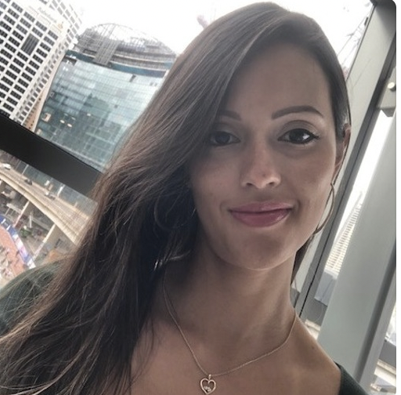
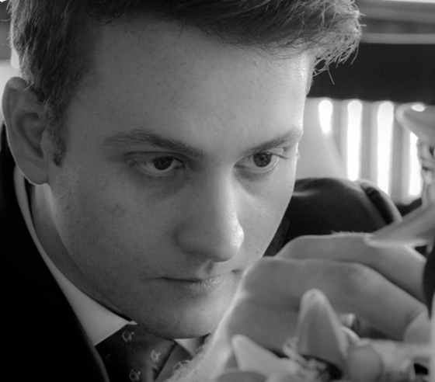
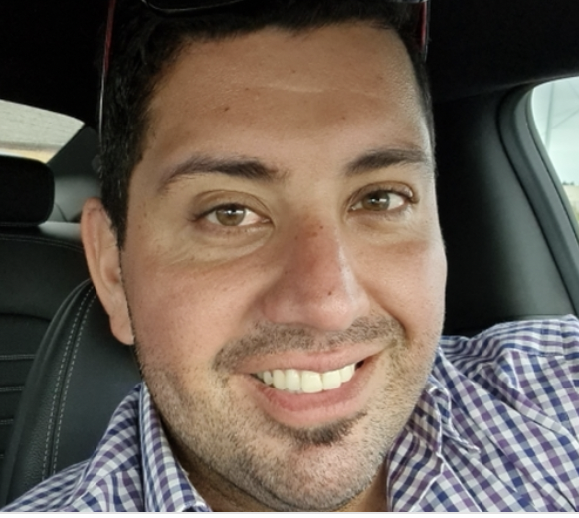
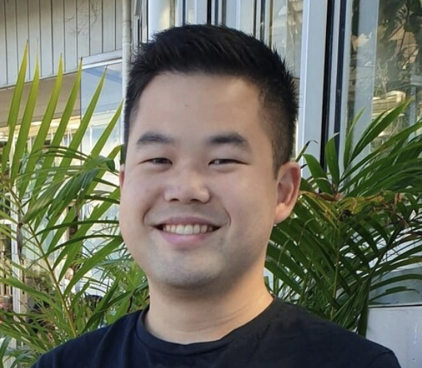
MEET THE TEAM
MEET THE TEAM TACKLING COVID
PAMELA MORENO
JAY RICHARDSON
PYTHON-CRYPTOLOGIST
CHIEF ENGINEER
JOHN LARDIS
MICHAEL YIP
PROJECT INTEGRATION
SMART CONTRACT ENGINEER/HACKER
Notes:
JL
*team intro
*ask for phones to be ready

Slide 3
1
Analyse Covid-Infection Rate
2
Simulate future Covid-Infections
Objectives
3
Build smart contract for Vax Records
4
Generate Vax Digital Certificate & QR Code
Notes:
JL

Slide 4
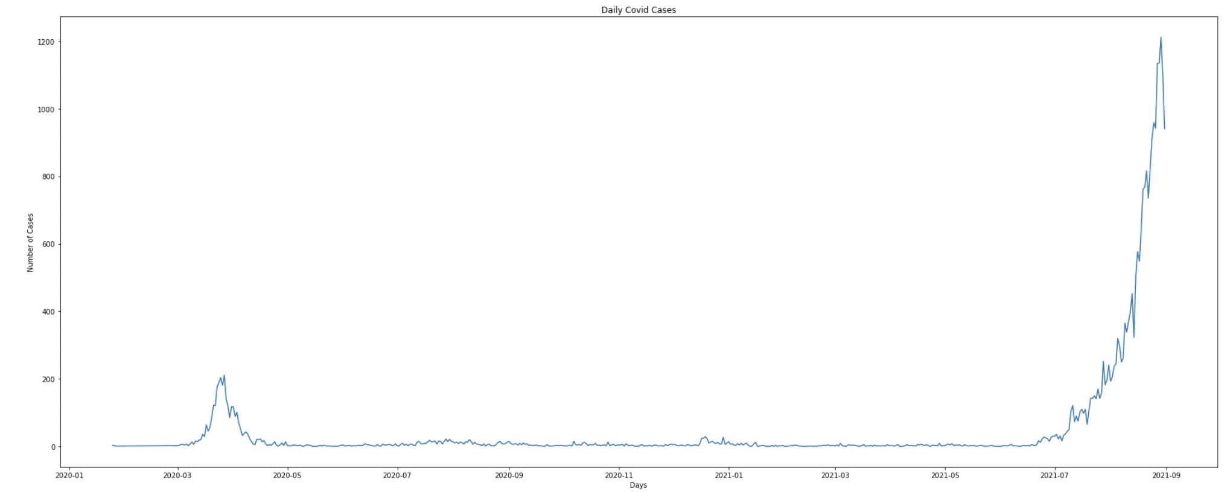
NSW - Daily Covid Cases
COVID CASES FROM COMMENCEMENT OF PANDEMIC.
Data Analysed 15/1/2020 to 31/08/2021
Reach max daily cased of 1,212 on 29/08/2021
Notes:
JR
to start, we went to data.nsw to source our covid data. The data was a record of individual cases by date, postcode, age group, local health district and government association.
Period analysed first covid case 25/01/2020 - 31/08/2021
To start cleaning up the data, we removed null values, standardised data types, added a count column and dropped the government and health columns that we didn’t need.
At first, we made a simple plot to visualise the data and we can quickly notice that the rate of infection in NSW has been increasing dramatically with the highest daily cases being 1,212 on 29/08/2021 and we wanted to investigate this data further.

Slide 5
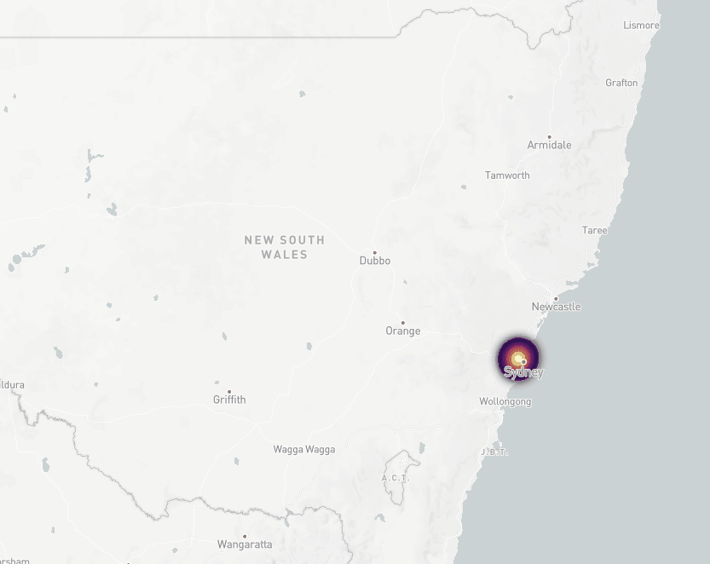
NSW - Covid Cases over time
COVID CASES FROM COMMENCEMENT OF PANDEMIC.
Concentration of Covid cases commenced within a single hot spot in Sydney
The spread quickly took effect and started to reach regional NSW
Notes:
JR
Using the pgeocode package in Python, I was able to loop through our data frame and convert each postcode to latitude and longitude data to plot the daily cases on a map of NSW.
We developed a visualization tool to understand the spread of Covid in NSW and animated it in a time lapsed heat map.
As you can see, the concentration of cases were primarily within Sydney Metro, however as cases started to accumulate, this started to spread into the regional areas.
From this data, we began to question how fast and the spread of Covid would reach within the next 14 to 30 days.

Slide 6
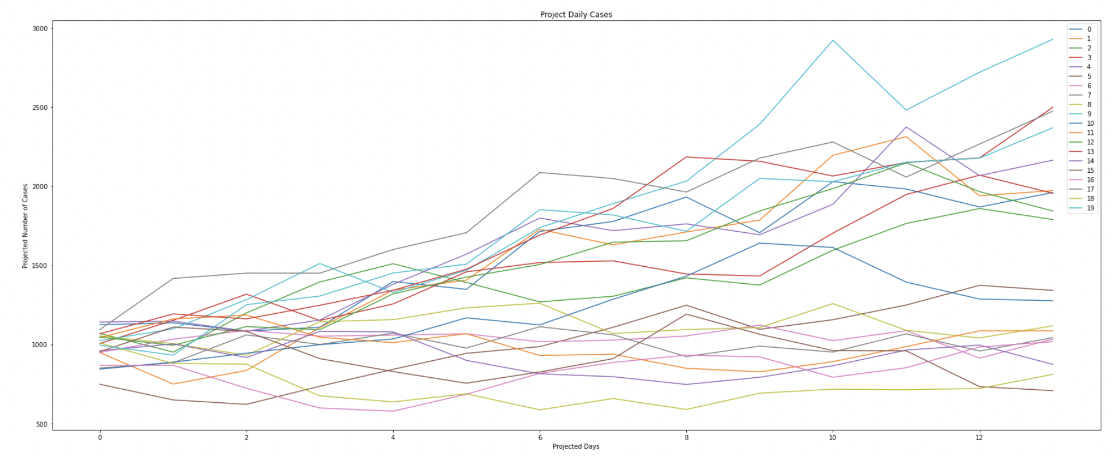
Projected Covid Cases in NSW
Simulation 1 based on 14 days
Notes:
JL
To understand the likely projection of Daily Covid cases we developed two main scenarios
1) Projection of Covid Cases across the next 14 days and...

Slide 7
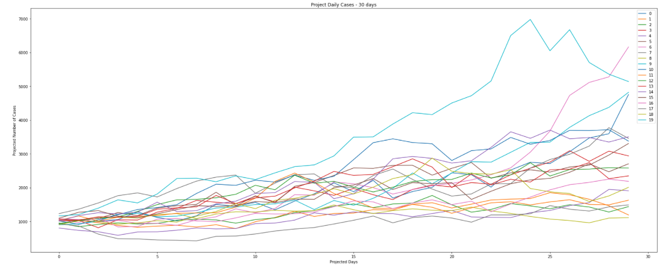
Projected Covid Cases in NSW
Simulation 2 based on 30 days
Notes:
JL
2) Projection of Covid Cases across 30 days.
To do this, we adopted a Monte Carlo simulation and ran 20 simulations across both options to understand how serious Covid Cases would grow. We used both the standard deviation and mean from the last 14 days of actual data to make these projections.
The results were surprising and illustrated some dire worst case scenarios.

Slide 8
NSW Projected Daily Cases
1,312
in 14 days
1,906
in 30 days
Notes:
JL
Daily cases if left with the same trajectory as the last 14 days of actual data, our Monte Carlo simulations suggested that in 14 days, average daily cases could reach 1,312 cases. In 30 days this would reach on average 1,906 cases.
Taking in the worst case simulation from both the 14 day and 30 day scenarios, maxim daily cases could reach to 2,927 and 11,900 cases per day respectively.
Whilst these are the worst case scenarios, these illustrated the dangers of leaving Covid-19 uncontrolled.
Keeping this in mind and in in line with the NSW state governments push to increase the vaccination rate across the state, the ChainVax team set out to achieve a seamless way to ensure vaccination data is kept safe, easily accessed and had the ability to be stored in a decentralised way which would allow for potential globally scalability and adoption. Using the benefits of BlockChain technology, we set out to digitise Vaccination records.

Slide 9
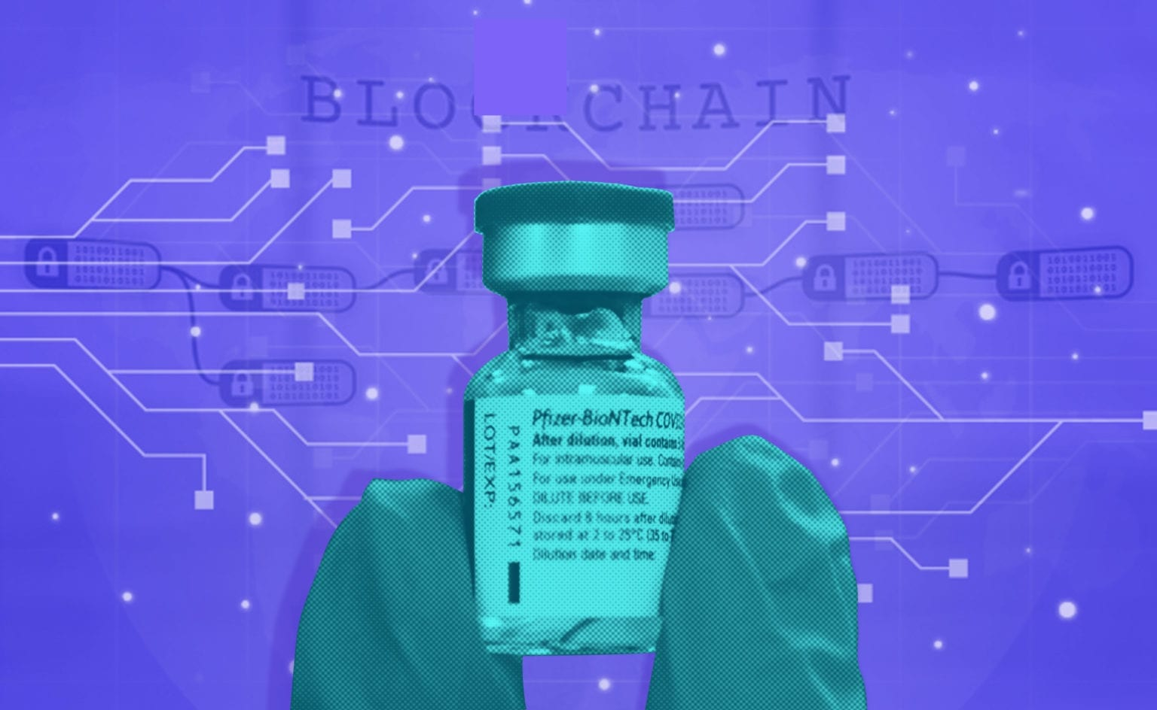
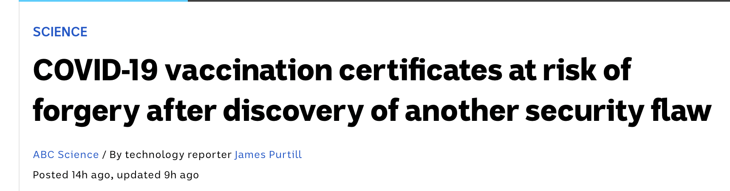
We knew this was going to be a problem….
10/09/2021
Notes:
JL
We knew authentication was going to be a challenge for traditional technology to ensure the validity of certificates.
During the development of our project , this article from the ABC was published highlighting a security flaw with the current technology being adopted by the government, that allows for Vaccination certificates to be illegally forged. Something that ChainVax resolves.
Over the Michael who will be stepping us through some of the key benefits of ChainVax.

Slide 10

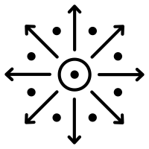
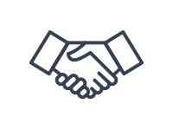
Benefits of ChainVax
Secure
Decentralised
Trustless
Secure way of storing vaccination records
No reliance on intermediaries or centralised databases
Know that records are authentic and can be accepted world wide
Notes:
MY
Security - Its immutable and no one can alter the records or copy versions of the vaccination certificate.
Decentralised - The platform supports global adoption across multiple organisations/governments/counties as no single access to a database is required. This would allow for a globally accepted standard in vaccination certificates. (Eg: Having a standard license)
Trustless - Creates a system by which the records can be shared and verified knowing that it can not be corrupted and a consistent standard applied to all records.
Thank you John.
As John mentioned the forgery breach, there is where ChainVax shines as we are completely secure with our records stored in the blockchain. We are also decentralised and can be accessed globally making us a highly flexible solution to vaccination veritability. With us, you can be entirely sure that records are authentic and we strive to unite people across borders with our trustless blockchain system.

Slide 11
Implementing a ChainVax certificate
Input Vaccination Info into front end
Request sent to Solidity
Solidity deploys Count #
Count Sent to Python file
Cert Image created and sent to pinata
Python sends URI to Solidity with inputs
Final URI sent back to Python
Appended JSON sent to Pinata
Append IMAGE file to JSON URI
Pinata sends back to Python URI for Image
NFT Minted
QR Code Created
Python
Solidity
Pinata
Notes:
MY
Emphasis is that we create two main products
1) NFT (include Data and Certificate) and
2) QR Code
As a group, we went through multiple iterations of our workflow and finally settled with this complete roadmap. The process was tricky as there were many moving parts and also different programs to consider.
There are colour coded legends for the 3 programs we used in this diagram so please keep that in mind.
Now, what we needed to do is process our patients input data and translate that into a final QR code and NFT for their future referrals.
We first parse through the patients input into python and that generates a w3 request to retrieve the id count from our solidity contract. The patients data in addition to the id count is then generated into a vaccination certificate in qr code and image form in which the image is sent to Pinata for an image URI. We take that image URI and append it unto a JSON file with the patients data, and send that to Pinata a second time for their metadata URI. From here, we incorporate the patients data and our metadata URI into our solidity contract which then mints our NFT and sends it to our patients wallet.

Slide 12
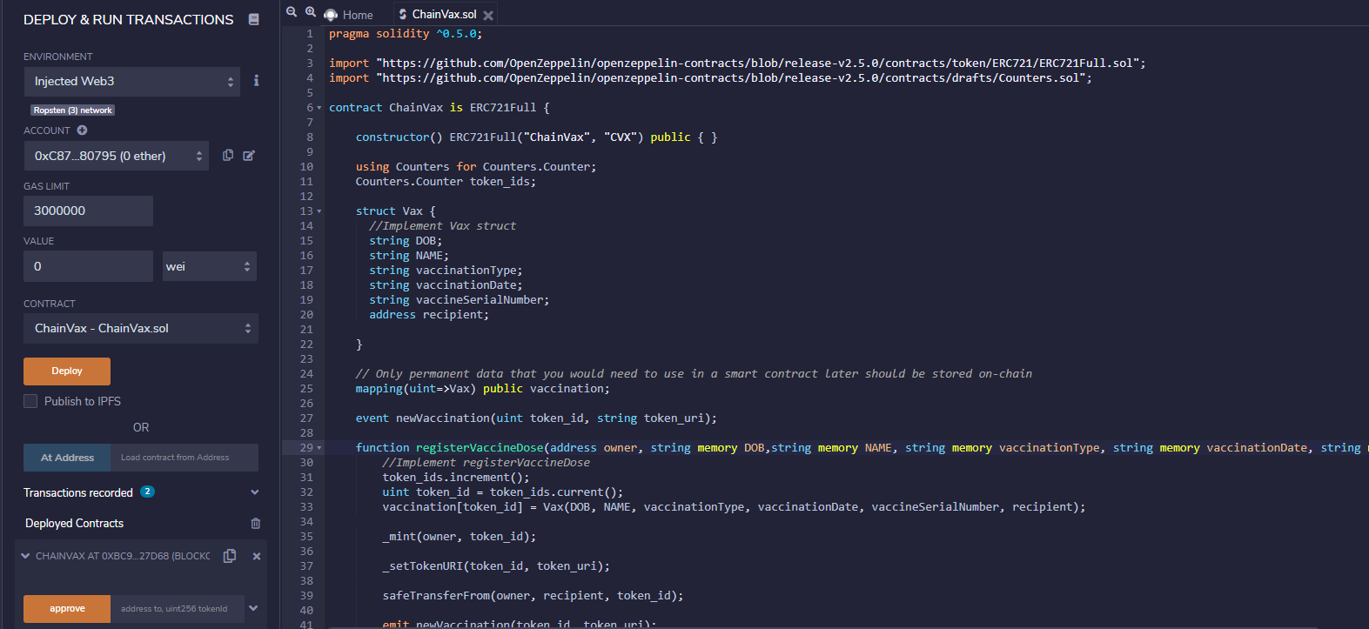
Deploying the NFT
imports
struct
function
Notes:
MY
This is a snapshot of our contract in solidity and it was rather simple to build as we utilised common contract building basics. We imported Counters and ERC721 sol files to record increasing users and implement the backbone for non-fungible token minting. A struct was also incorporated around patient input variables to organise their vaccination details. Lastly, the registerVaccineDose function takes all of the inputs and generates our final product, the NFT.
Thank you and on to you Jay.

Slide 13
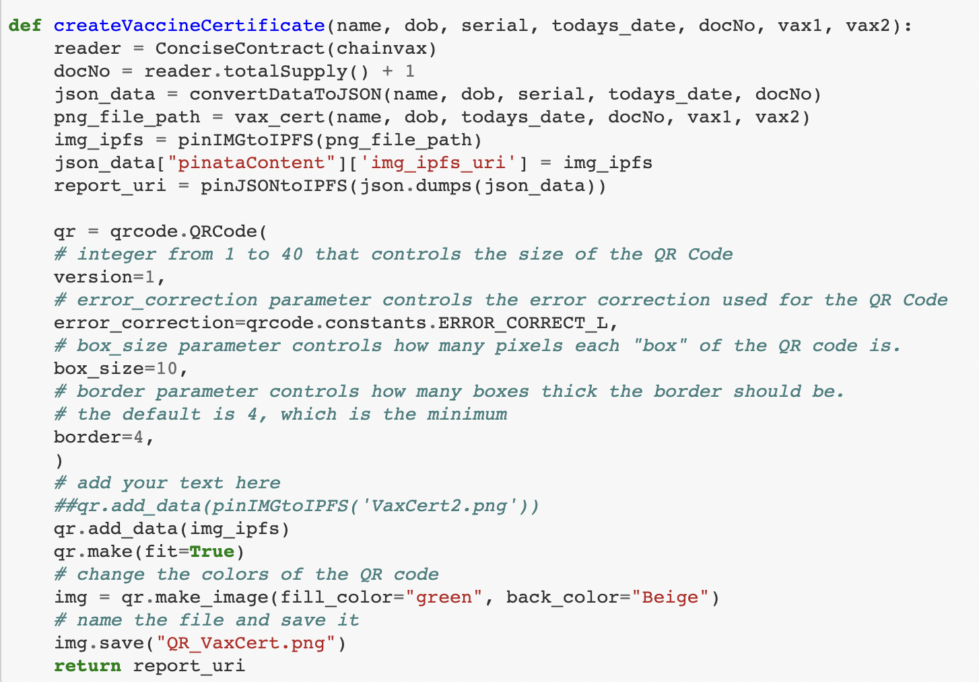
Converting Variables and Cert into URI for Solidity
COVID-19 is an infectious disease caused by a new virus.
Requests count of NFT’s and adds 1 to create a unique ID
Uses the vax_cert function
Sends, appends and hosts image and JSON data to IPFS
Creates QR code of the Vaccine Certificate
Notes:
JR
In our main Python workbook, we wrote six core functions that together can create our vaccination certificate:
the first converts data to a JSON file
the second pings an image to Pinata to be hosted on the IPFS
the third sends the now converted JSON data to be hosted on the IPFS
the fourth takes all our input data and creates a new image certificate
the fifth creates a QR code of our certificate
the sixth function, which you see here, takes all the previous functions and packages them into one

Slide 14
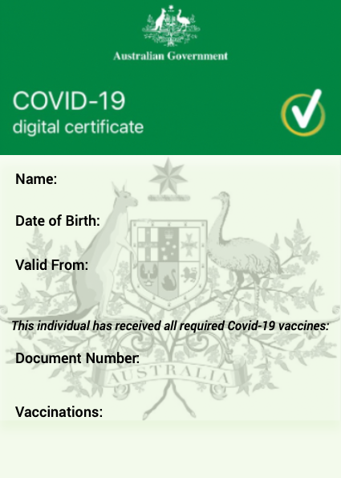

Generation of Covid Certificate
COVID-19 is an infectious disease caused by a new virus.
OpenCV-Python is a library of Python bindings designed to solve computer vision problems.
Notes:
PM
For this we have used a new & nice library called OpenCV
Opencv: Is a huge open-source for computer vision, machine learning, and image processing. It can process images and videos to identify objects, faces, or even the handwriting of a human.
Some basic parameters that opencv library contains are:
Reading a image
Converting a image to greyscale
Color spaces
Resize an image
Save image
Reading video, etc
As you can see on the image, first we have created this template through an external designing application, then we used OpenCV module within Python to read our Template and given the parameters needed for the Vaccination Certificate… such as name, dob, valid from, Doc num & vaccinations to write texts, in other to do that we provided some coordinates to our function so it can display all different texts on the exact location anytime when a certificate gets created...

Slide 15

Generation of QR Code
COVID-19 is an infectious disease caused by a new virus.
Qrcode is a two-dimensional pictographic code used for its fast readability and comparatively large storage capacity.
Notes:
PM
We used this other new library to store our Vaccination Certificate once the URI has been sent from pinata…
QR-Code is a two-dimensional version of the Barcode able to convey a wide variety of information almost instantly with the scan of a mobile device.
Some of the parameters used to define the QR Code were:
Box Size = Parameter that controls how many pixels are in each “box” of the QR code.
Border = Parameter that controls how many boxes thick the border should be
Version = This parameter specifies the size and data capacity of the code.
Error: This parameter sets the error correction level of the code.
and some other parameters..
The idea of having a qrcode is that it will be easier to carry it on anywhere you are…

Slide 16
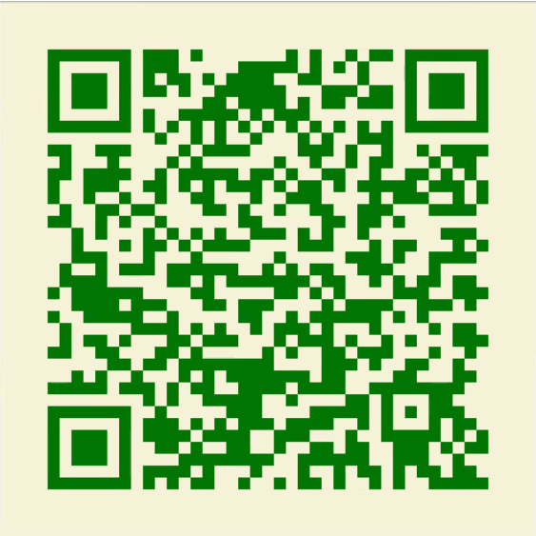
Please take out your phones and scan the following QR Code
COVID-19 is an infectious disease caused by a new virus.
Notes:
I would like you guys if can grab your phone and scan this beautiful designed qrcode of the vax certificate
** if anyone misses this slide, it’s posted on slack

Slide 17
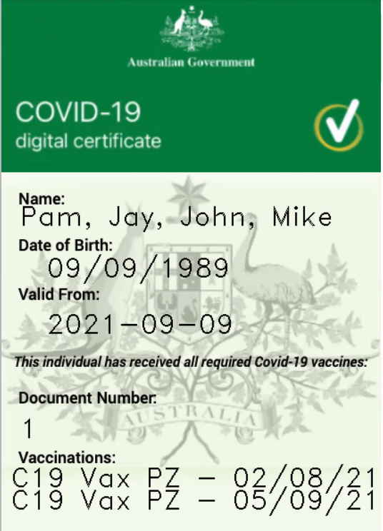
Your Covid -19 Certificate is Ready!!
Notes:
PM
Here you guys got your covid-19 certificate ready to go anywhere across the globe without any boundaries :)
Something pointing out is that the “Document number” came from the smart contract, so anytime a certificate is created, it issues a new number.

Slide 18
Potential Improvements
Integrate the front end to allow an API integration into existing systems.
NFT’s could be used for a reward based scheme to provide an incentive- discounts applied, lottery system, or link back to ability to purchase tickets.
Encryption of personal data before the data is presented to the blockchain.
Notes:
PM - some of the Potential Improvements that we have considered are:
Integrate the front end to allow an API integration into existing systems.
NFT’s could be used for a reward based scheme - discounts applied, lottery system, or link back to ability to purchase tickets, providing discount…….
Encryption of personal data before the data is presented to the blockchain.

Slide 19
Key Findings
We had to develop a workflow to integrate from 3 different workbooks and timings in the process.
Capturing both the JSON data and the Vaccination certificate into a single URI that could be used in the Smart contract.
Creating a unique certificate number that could be called into the Python and into the certificate.
Data that is linked to the QR code needs to to be hosted.
When using OpenCV, modifying the text size on the image was challenging.
Limited documentation to interact with the Pinata API for handling of images.
Notes:
JL
Thanks Pamela - We observed 6 key findings during the development of ChainVax. These were:
We had to develop a workflow to integrate from 3 different workbooks and timings in the process.
Capturing both the JSON data and the Vaccination certificate into a single URI that could be used in the Smart contract.
Creating a unique certificate number that could be called into the Python and into the certificate.
Data that is linked to the QR code needs to to be hosted.
When using OpenCV, modifying the text size on the image was challenging.
Limited documentation to interact with the Pinata API for handling of images - to overcome this we had to reverse engineer the the html front end to create variables that can “ping” an image with the Pinata API.
This concludes our presentation on ChainVax, hope everyone enjoyed it. The ChainVax team is now open to take any questions from the group.

Slide 20
THANKS
ChainVax has protected your Covid-Certificate

